Slide 1
Investigating the link between human fatigue and manufacturing assembly quality
Alex Steed

Slide 2
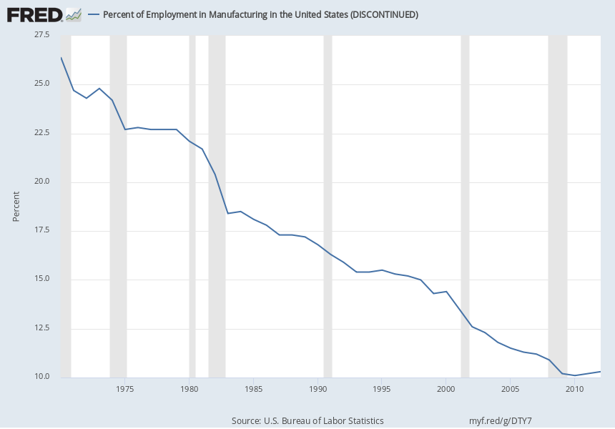
Human workers in manufacturing
[https://fred.stlouisfed.org/series/USAPEFANA, 2020-07-28]
Steady decline in #employees in manufacturing.

Slide 3
A change in the nature of work
“computer-controlled systems ... results in the reduction of number of seafarers working in ships.” [1]
Data collected ... indicate the number accidents is increasing and are mostly caused by the people on board“ [1]
Fewer people → longer hours → heavy paperwork → new procedures → more complex tasks.
  (Hard work → complex work).
[1] Bal, E., Arslan, O., & Tavacioglu, L. (2015).
Prioritization of the causal factors of fatigue in seafarers and measurement of fatigue with the application of the Lactate Test.
Safety Science, 72, 46–54. http://dx.doi.org/10.1016/j.ssci.2014.08.003

Slide 4
Purpose
Investigate the relationship between manufacturing quality and human fatigue.
Why:
  Manufacturing quality is a competitive requirement.
  Humans are integral part of manufacturing.
Fatigue = Decreased performance due to prolonged exposure
Quality = The likelihood of a defective product.

Slide 5
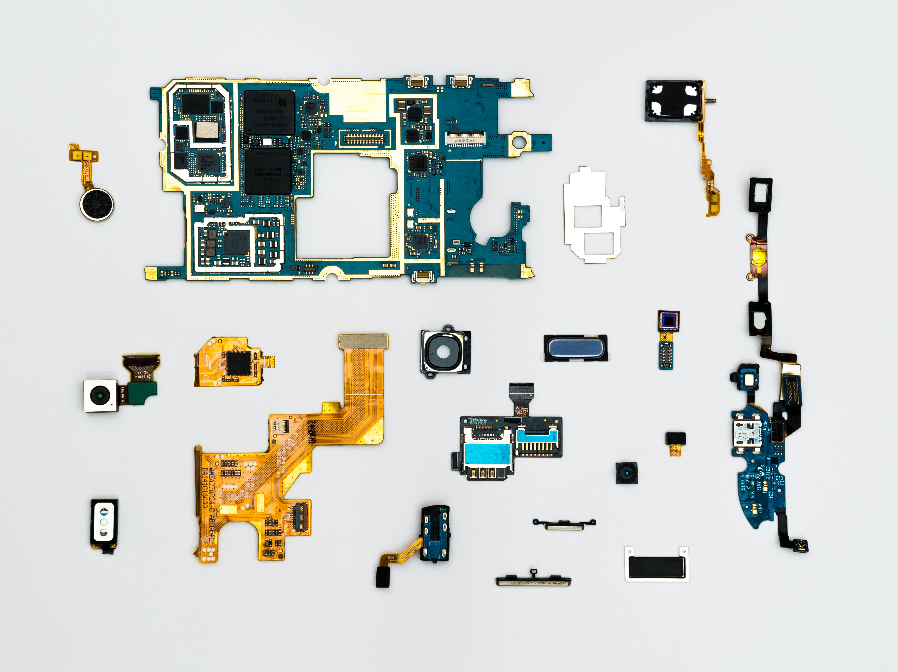
Assembly quality (simplified)
Microphone 0.99
Defect accumulation in assemblies
Chance of defect
  Total = 0.99*0.99*0.99
  0.97
Camera 0.99
Button 0.99

Slide 6
Method
How do we measure fatigue?
Fatigue factors
Time of day
Day of week
Previous workload
...
Quality output
Assembly tolerance
Chance of failure
Chance of injury
...
Individual
fatigue
state
Notes:
How do we measure fatigue? We can’t we can only observe its effects.

Slide 7
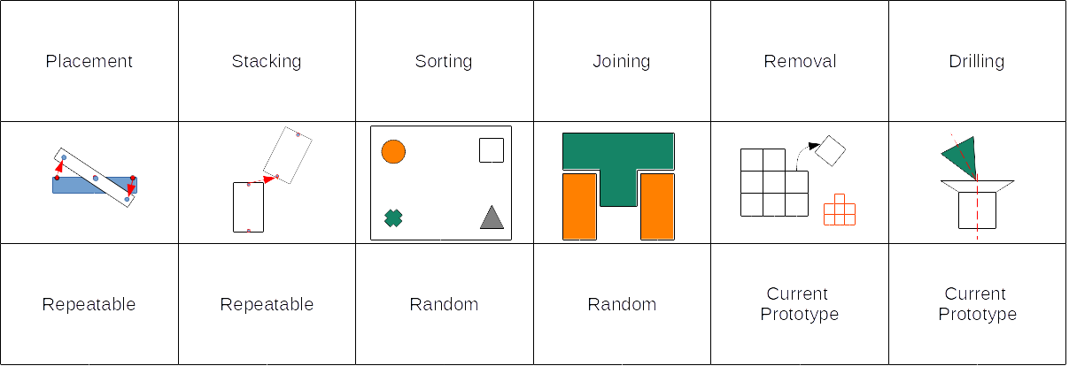
How did we measure? (Video demonstration)
Increase in task complexity

Slide 8
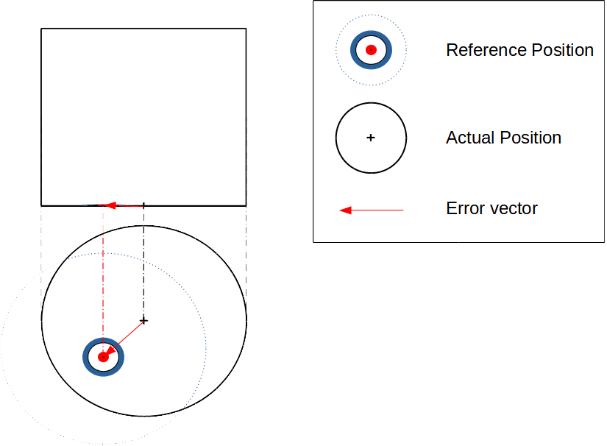
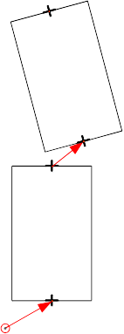
Dimensional error
The difference between the reference and actual position.

Slide 9
Learning: Duration
Known phenomena [2]
Learning decreases task duration
[2] Fruggiero, F., Fera, M., Lambiase, A., Maresca, P., & Caja, J. (2017).
The role of human fatigue in the uncertainty of measurement.
Procedia Manufacturing, 13, 1320–1327. https://doi.org/10.1016/j.promfg.2017.09.092

Slide 10
Learning: Deviation
Learning increases assembly deviation

Slide 11
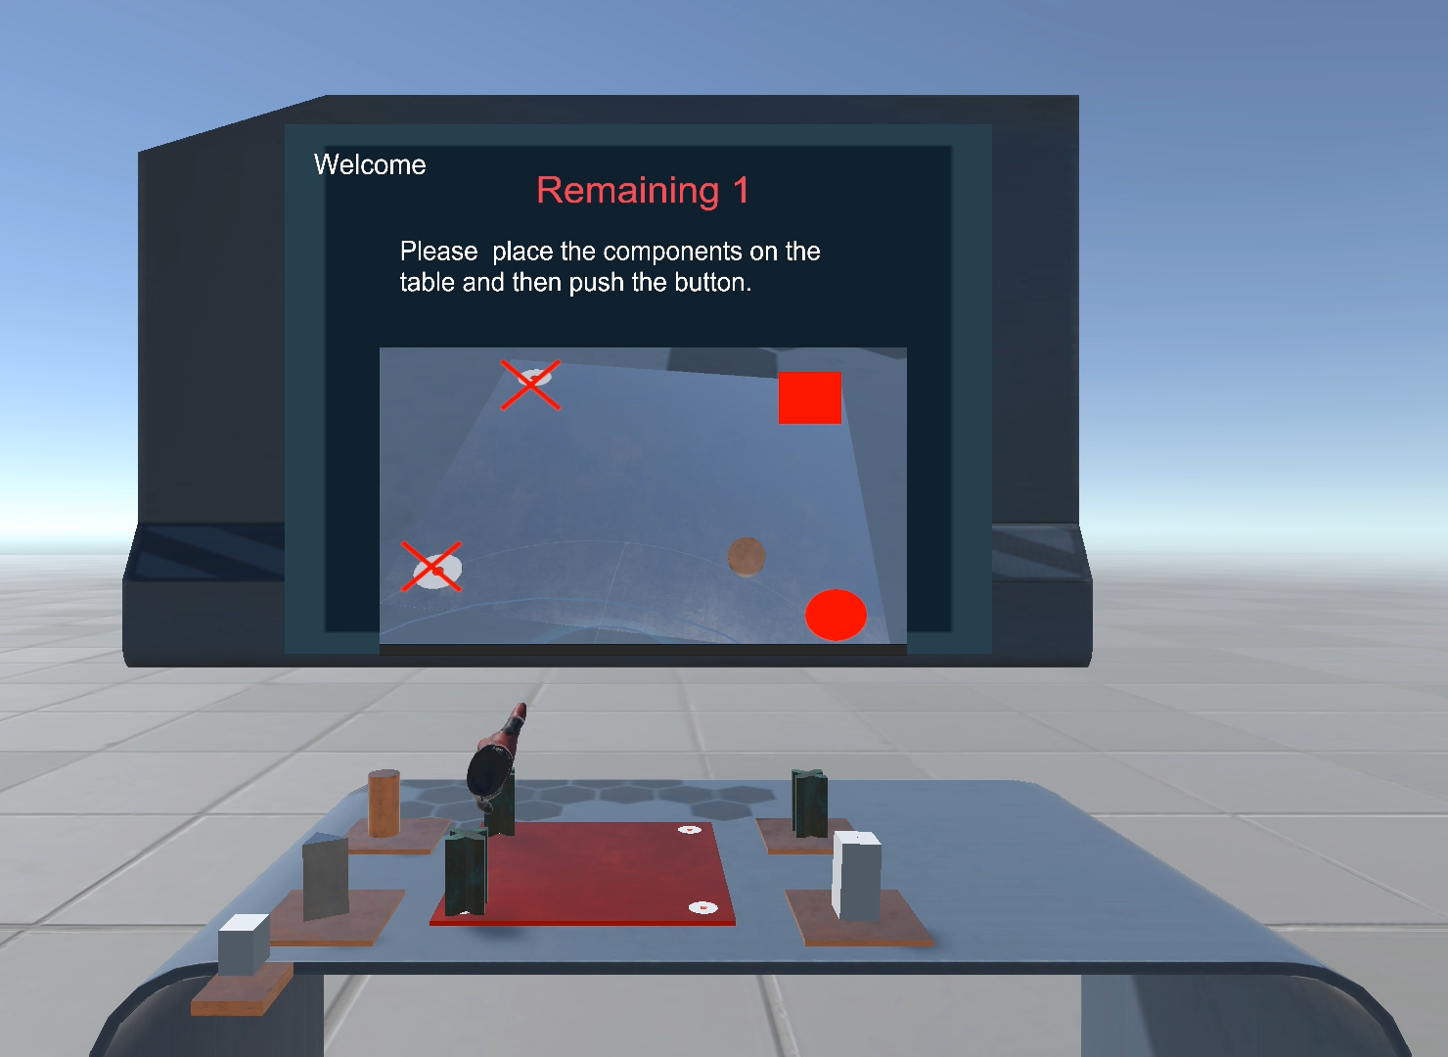
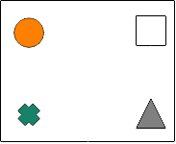
Discrete error
Does the formula match?
  Error in judgment
  Injury

Slide 12
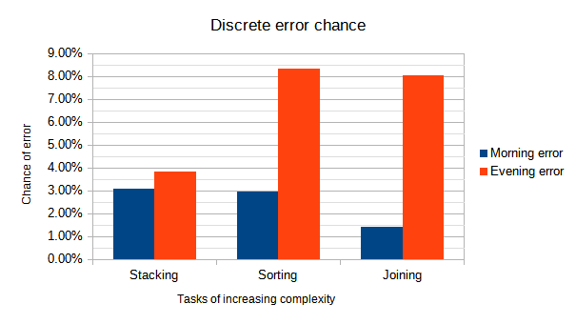
Time of day
Increased chance of discrete errors later in the day. [3]
Morning error is constant
Random tasks have higher evening Error chance
Placement task omitted due to learning/introduction errors
[3] Folkard, S., & Lombardi, D. A. (2006). Modeling the impact of the components of long work hours on injuries and “accidents.”
American Journal of Industrial Medicine, 49(11), 953–963. https://doi.org/10.1002/ajim.20307

Slide 13
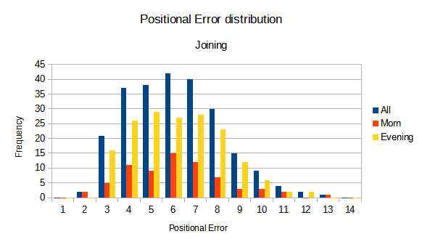
Fatigue has little effect on dimensional error
Time of day
Number of trials

Slide 14
Experimental validation
We have confidence in the experiments ability to measure because we observed:
  Learning reduces task duration [2].
  Discrete error increase rates later in the day [3].
Notes:
Known phenomena

Slide 15
Experimental Findings
We also found that:
  Task complexity increases the discrete error later in the day.
    Random vs Repeatable
  Time of day has little effect on dimensional error.
  Learning can negatively effect dimensional error deviation.

Slide 16
Conclusion
Scheduling should consider quality, not only make-span [1].
More relevant models of human fatigue are necessary [4].
[4] Kolus, A., Wells, R., & Neumann, P. (2018). Production quality and human factors engineering: A systematic review and theoretical framework. Applied Ergonomics, 73(October 2017), 55–89. https://doi.org/10.1016/j.apergo.2018.05.010

Slide 17
Thank you!

Slide 18
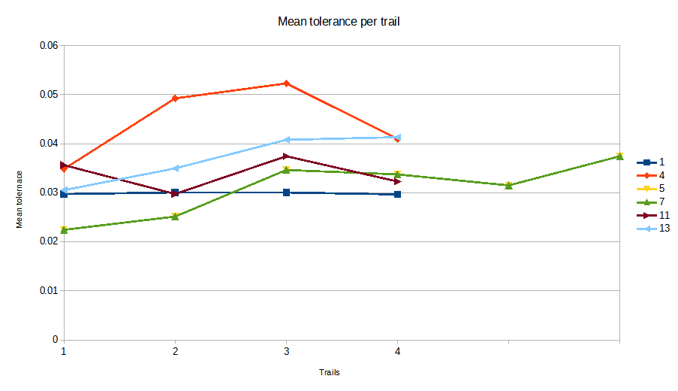
Learning: Mean

Slide 20
Outline
Humans in manufacturing
Human fatigue
Quality in manufacturing
Experimental design
References (Table)

Slide 21
Human fatigue
Decrease in ones performance due to prolonged exposure.
Examples:
  Physical fatigue (time-under-tension)
  Cognition (recognizing patterns)
Solve using ...

Slide 22
Human fatigue domains
Airplane pilots [1,14,15]
Long distance drivers [18,19,21,23]
Marine [7,10]
Manufacturing [2,3,4,8,24,25,26,27]
General workplace [5,6,9,11,12,13,16,17,20,22]

Slide 23
Human fatigue literature
Studied for safety (2000’s)
  “Many of the industrial disasters of the last few decades, including Three Mile island, Chernobyl, Bhopal, Exxon Valdez, and the Estonia ferry, have occurred in the early hours of the morning.” [8] (2005)
Studied for throughput rate (2010’s)
  [9] Modeled duration taking HF into account (2009)
Studied for quality (2018+)
  The mistaken belief that Human Factors are strictly orientated towards safety has limited its contribution to performance aspects. [27]

Slide 24
Production quality (risk)
The likelihood of a defective product.
Quality has been broadly noted as being of strategic importance in manufacturing [26].
How can we measure it?
  Discrete errors. (Cognition)
  Dimensional errors. (Motor)
Shaft
Hole
Hole

Slide 25
Fatigue factors (from literature)
Task complexity
Time of day
Previous workload

Slide 26
Task complexity
Cognitive demand of a task.
More complex tasks generate lower reliability and higher probability error. [7]
Decision making [24, 16, 10, 13, 21, 26, 7, 5, 6]
  Judgment, Cognition, Logic, Computer-controlled
Schematic = high cognitive load
Notes:
Example:
Repeatable = low cognitive load
Assembly manual hole = high cognitive load.

Slide 27
Fatigue accumulation
Short term [8,9,29,15] (Time on task)
  Hours on duty
  Shift duration
  Time since last break
Medium term[8,14,9,15,10,7,16]
  Successive shifts (days of week)
  Weekly work hours
  “slept significantly more on non-workdays than on workdays” [14]

Slide 28
Experimental Design
Video demonstration
What was recorded.
What was analyzed

Slide 29

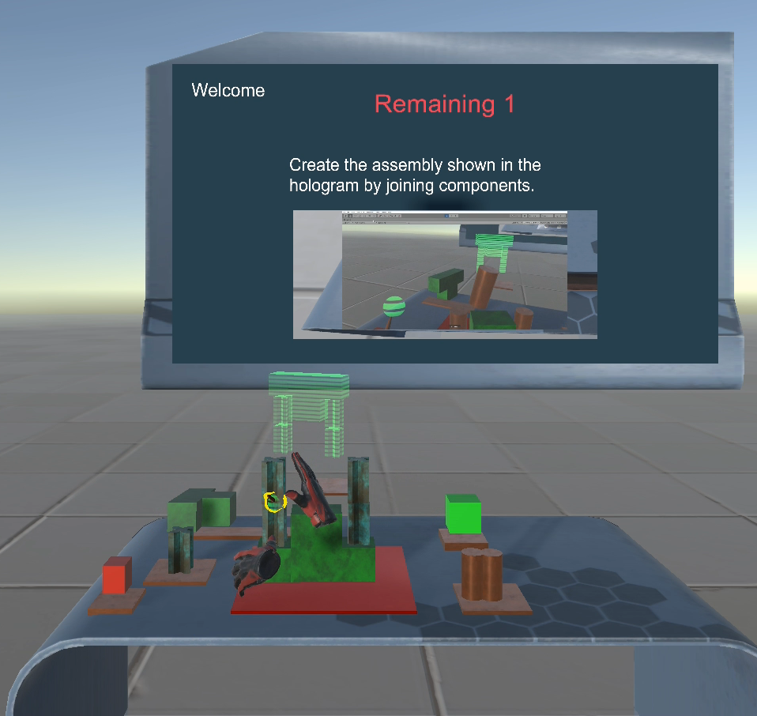
Discrete error
Does the product match the recipe?

Slide 30
Experimental Factors
Time-of-day → Measure
Task complexity → Estimate
Error (discrete) → Measure
Error (Tolerance) → Measure

Slide 31
Nuisance
Ergonomics → Controlled via table height calibration
Learning* → Gather sufficient trails to eliminate effect
Forgetting → Trails in one continuous week no weekends
Task order, previous workload → constant
Fatigue accumulation, Time since last break → constant
Fatigue accumulation, week-long → Investigate

Slide 32
Underestimation in joining errors
Only considered cognition errors, not dimensional errors.
Deviation
Trials
Dimensional errors can cause assembly to topple over

Slide 33
Future
Large volumes of data is being generated in manufacturing and we need to determine
  what data is relevant and
  how we can use it.

Slide 34
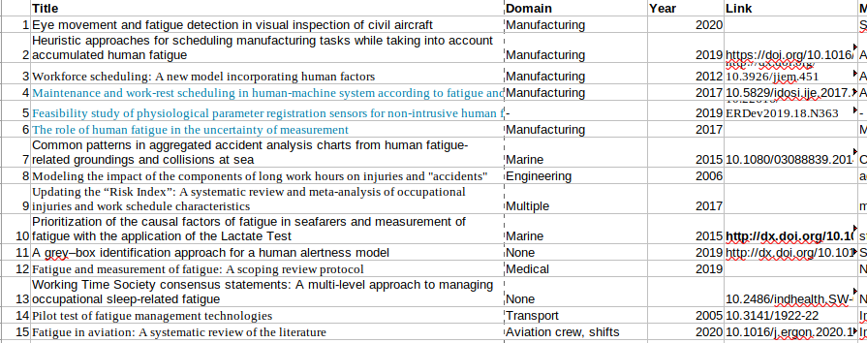
References

Slide 35
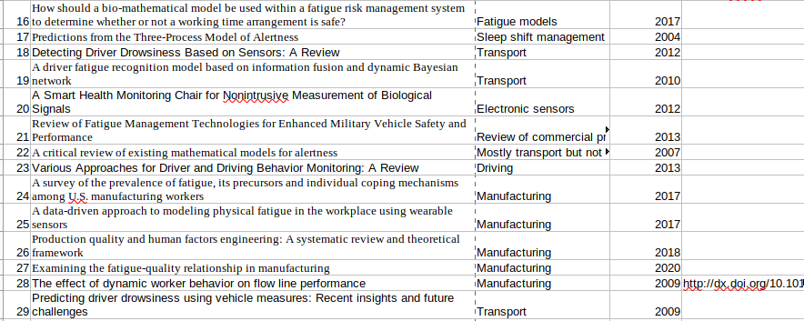
References

Slide 36
Decomposing task complexity
Emphasis should be on human, not design
# nature of task
# abstraction
of instruction
# unique parts
# operation
Cognitive
# duration
Complexity
# ergonomics
Motor
# parts

Slide 37
Human error table
Task | Morning error | Evening error | # morn | # even | Morn error | Ev error
1 | 22.22% | 14.88% | 27 | 168 | 6 | 25
2 | 2.96% | 3.67% | 135 | 354 | 4 | 13
3 | 2.99% | 8.36% | 134 | 371 | 4 | 31
4 | 1.41% | 8.06% | 71 | 186 | 1 | 15

